Slide 1
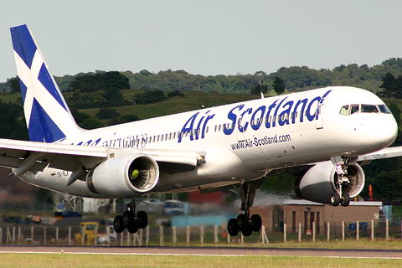
O’Hare International Airport Chicago, Illinois

Slide 2
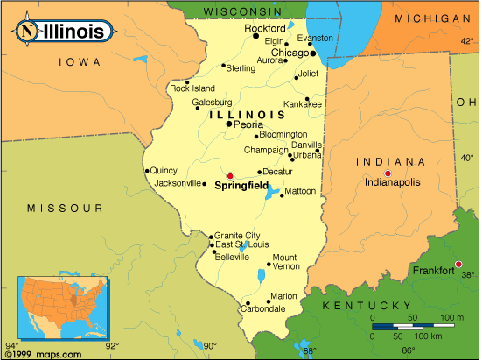
O’Hare International Airport
O’Hare Airport
Chicago, Illinois
Today, railroads, highways, and airports move more people and goods in and out of Chicago than any other American city!
Chicago has been a transportation hub since 1800’s

Slide 3
Questions
What is a transportation hub?
Where is the O’Hare International Airport?
1. A center for moving goods and people.
2. Chicago, Illinois

Slide 4
Credits
David.D
Rohin
Ryann

